Slide 1


Fundamentals of Music Processing
Chapter 1: Music Representations
Meinard Müller
International Audio Laboratories Erlangen
www.music-processing.de

Slide 2
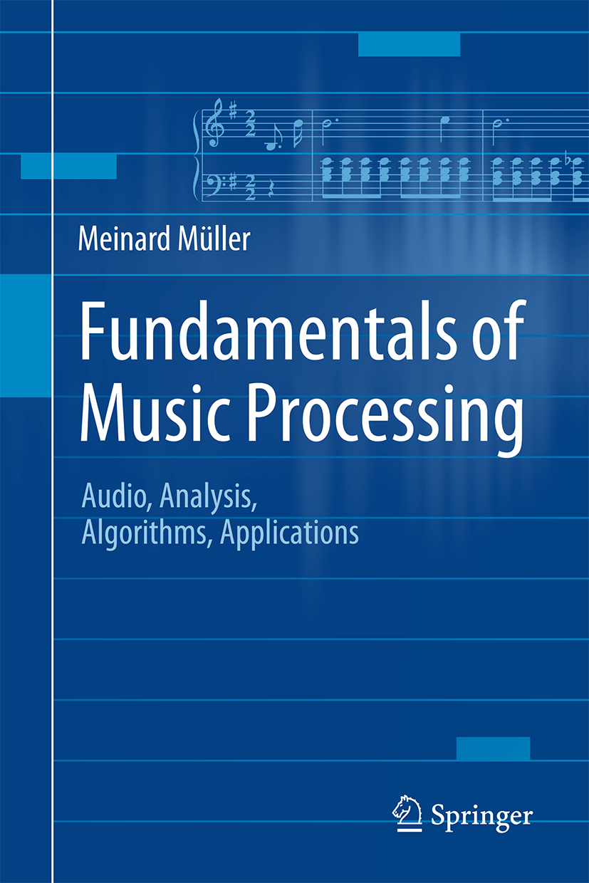
Book: Fundamentals of Music Processing
Meinard Müller
Fundamentals of Music Processing
Audio, Analysis, Algorithms, Applications
483 p., 249 illus., 30 illus. in color, hardcover
ISBN: 978-3-319-21944-8
Springer, 2015
Accompanying website:
www.music-processing.de

Slide 3
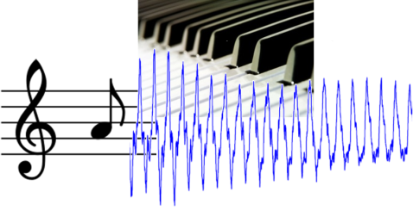
Chapter 1: Music Representations
1.1 Sheet Music Representations
1.2 Symbolic Representations
1.3 Audio Representation
1.4 Further Notes
Musical information can be represented in many different ways. In Chapter 1, we consider three widely used music representations: sheet music, symbolic, and audio representations. This first chapter also introduces basic terminology that is used throughout the book. In particular, we discuss musical and acoustic properties of audio signals including aspects such as frequency, pitch, dynamics, and timbre.

Slide 4

1 Music Representations
Teaser

Slide 5
1.1 Sheet Music Representations
Fig. 1.1

Slide 6
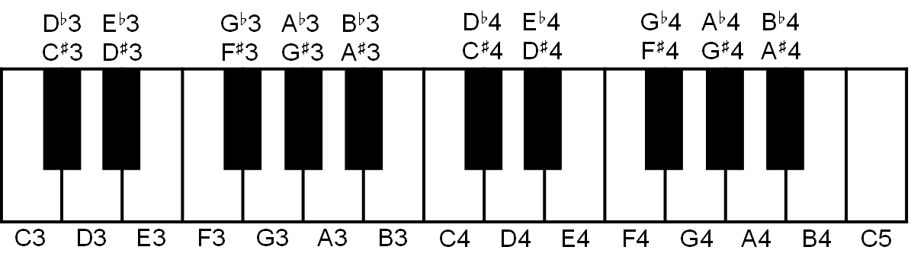
1.1 Sheet Music Representations
Fig. 1.2

Slide 7
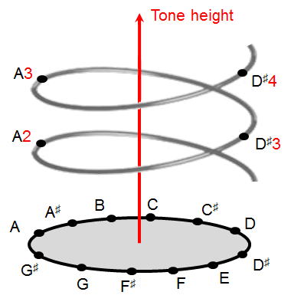
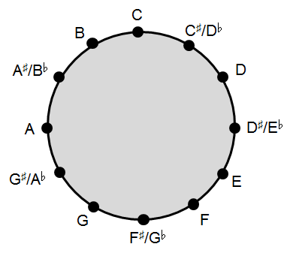
1.1 Sheet Music Representations
Fig. 1.3

Slide 8
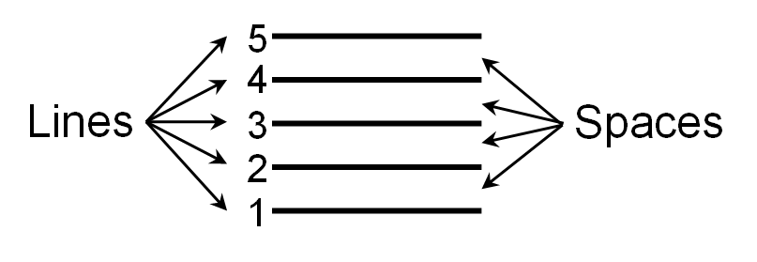
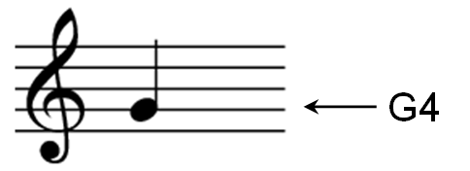
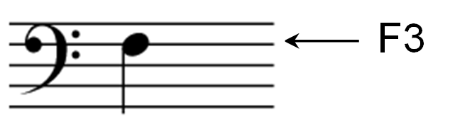
1.1 Sheet Music Representations
Fig. 1.4

Slide 9
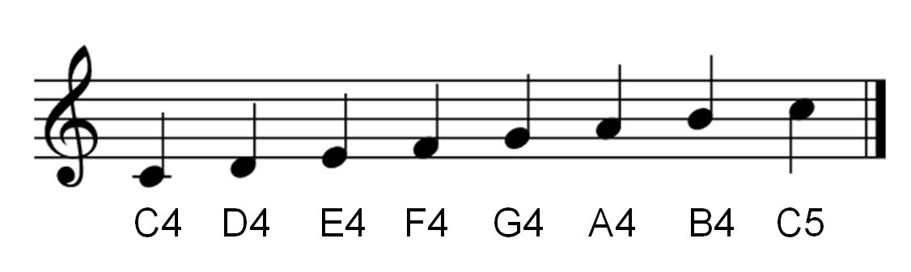
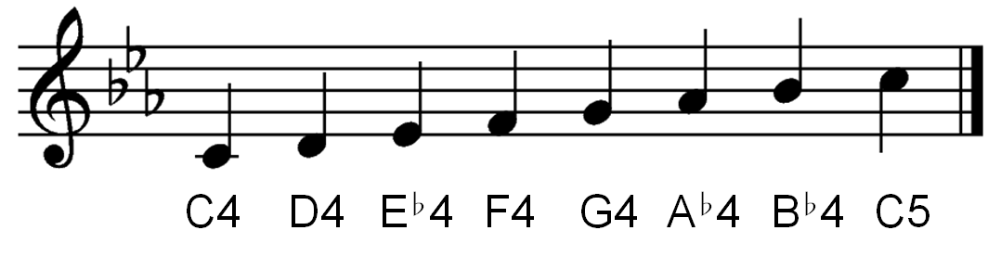
1.1 Sheet Music Representations
Fig. 1.5

Slide 10
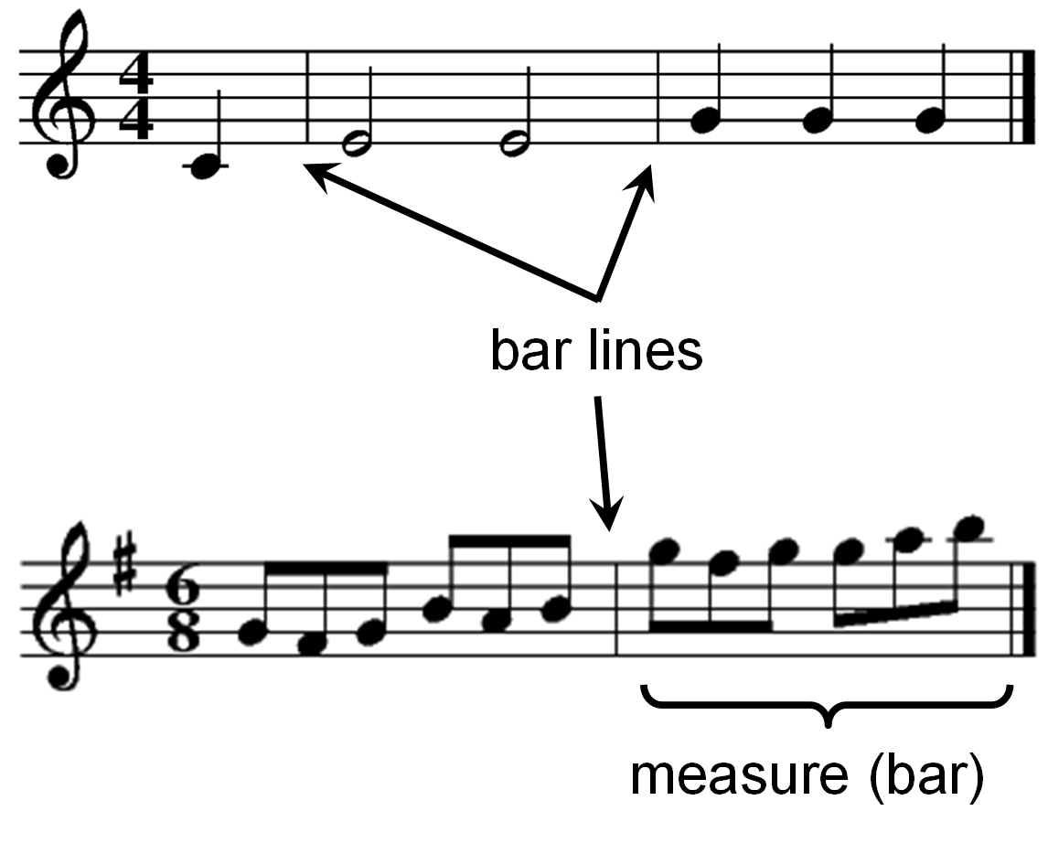
1.1 Sheet Music Representations
Fig. 1.6

Slide 11
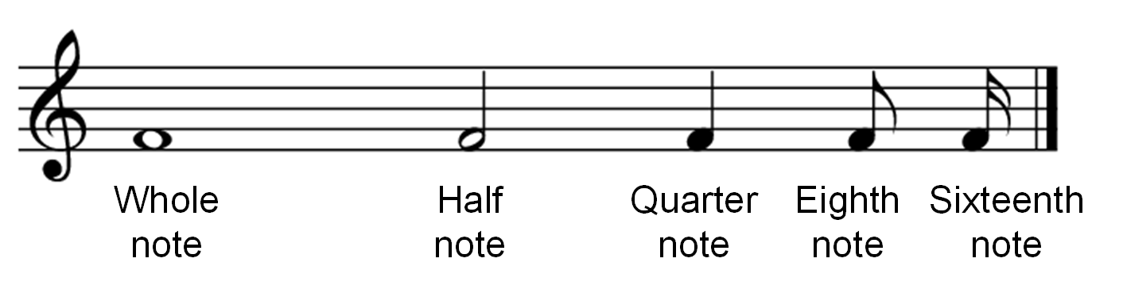
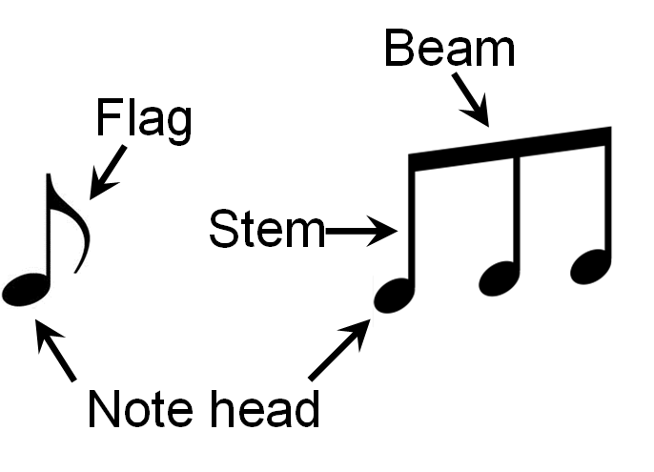
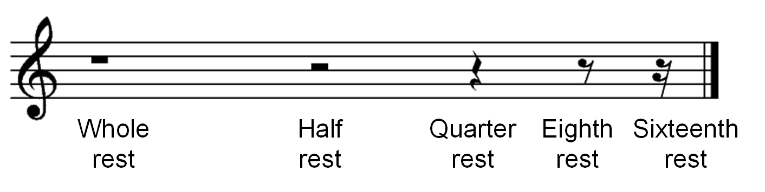
1.1 Sheet Music Representations
Fig. 1.7

Slide 12
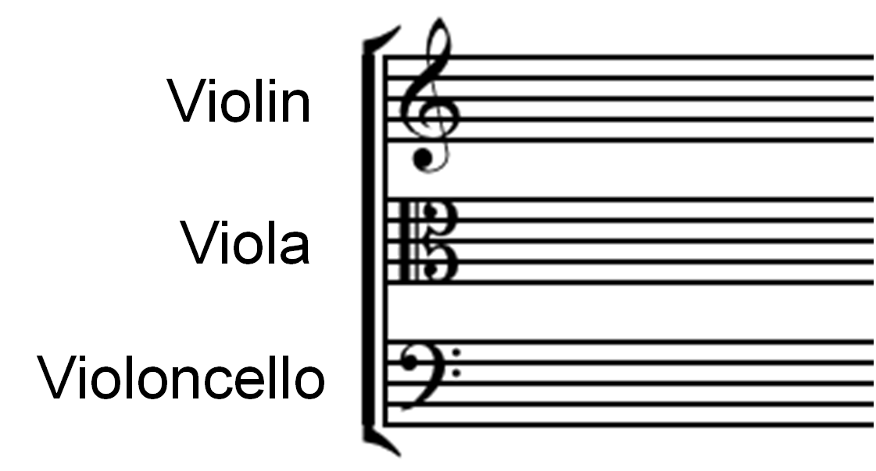
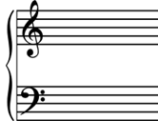
1.1 Sheet Music Representations
Fig. 1.8

Slide 13
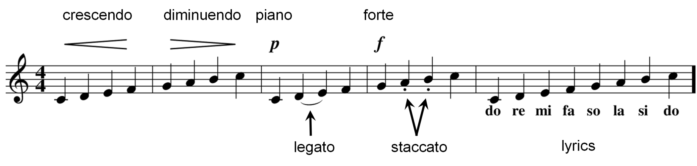
1.1 Sheet Music Representations
Fig. 1.9

Slide 14
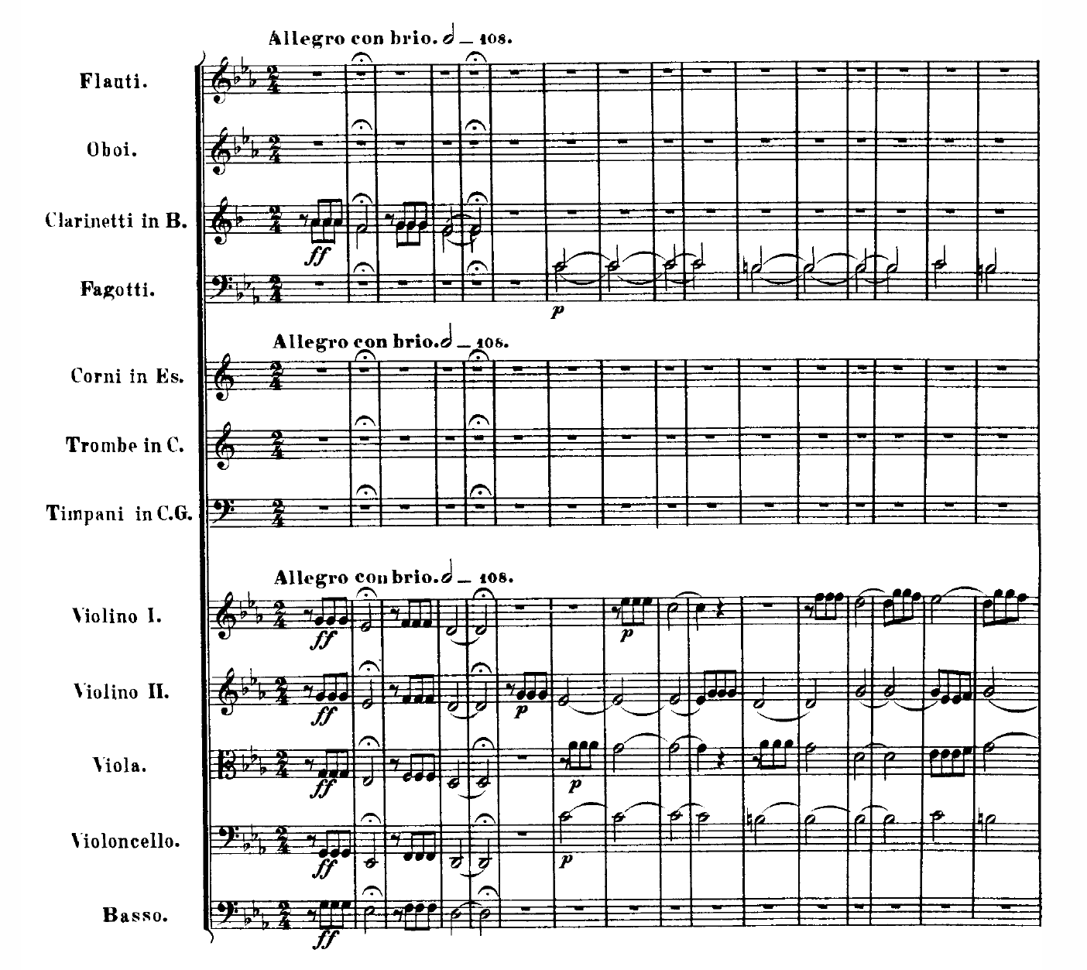
1.1 Sheet Music Representations
Fig. 1.10

Slide 15
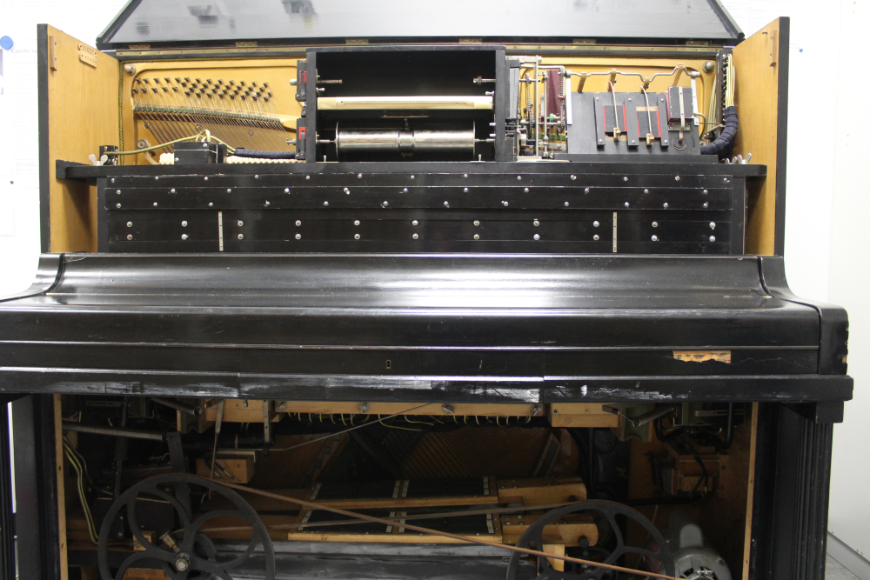
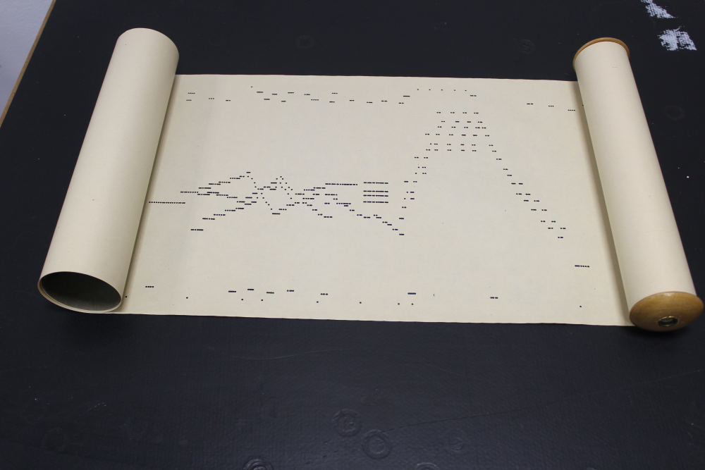
1.2 Symbolic Representations
Fig. 1.11
Reprinted by kind permission of the Institut für Musikwissenschaft
der Goethe-Universität Frankfurt

Slide 16
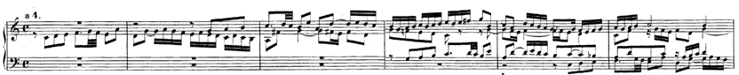
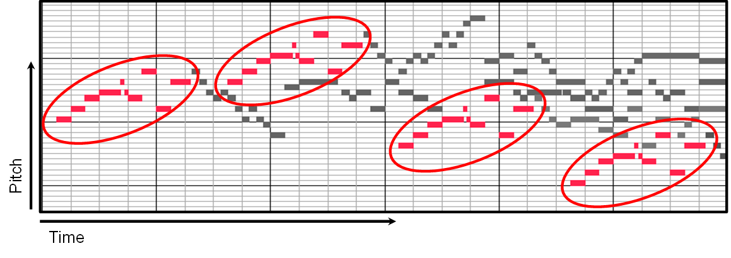
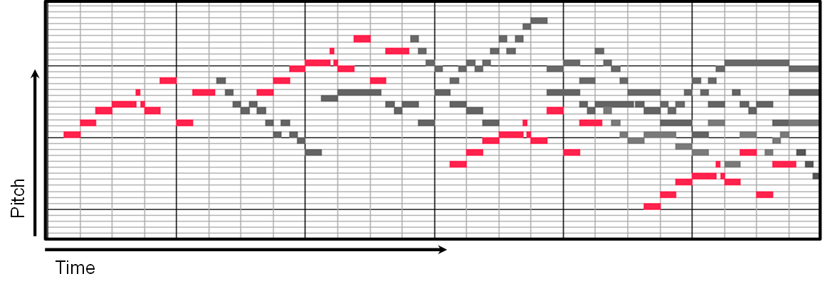
1.2 Symbolic Representations
Fig. 1.12

Slide 17
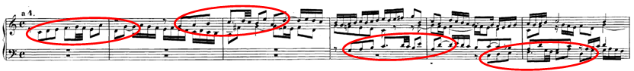
1.2 Symbolic Representations
Fig. 1.12

Slide 18
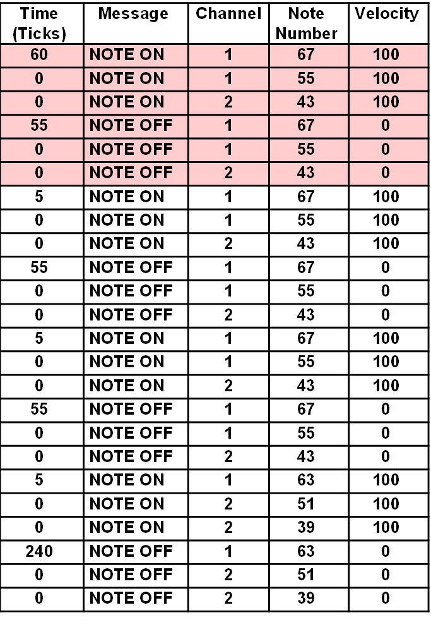
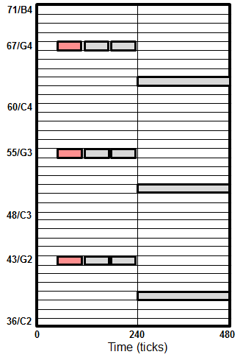
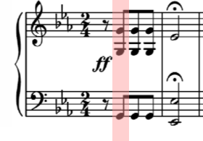
1.2 Symbolic Representations
Fig. 1.13

Slide 19
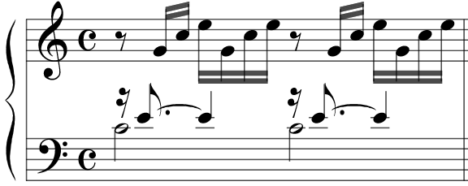
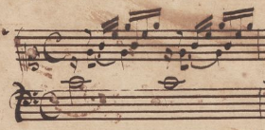
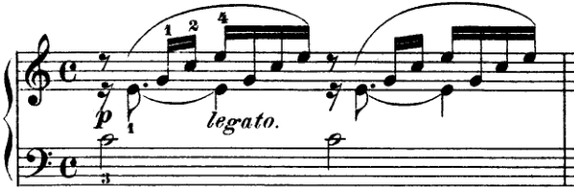
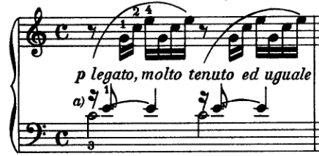
1.2 Symbolic Representations
Fig. 1.14

Slide 20
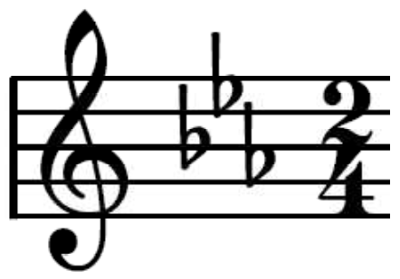
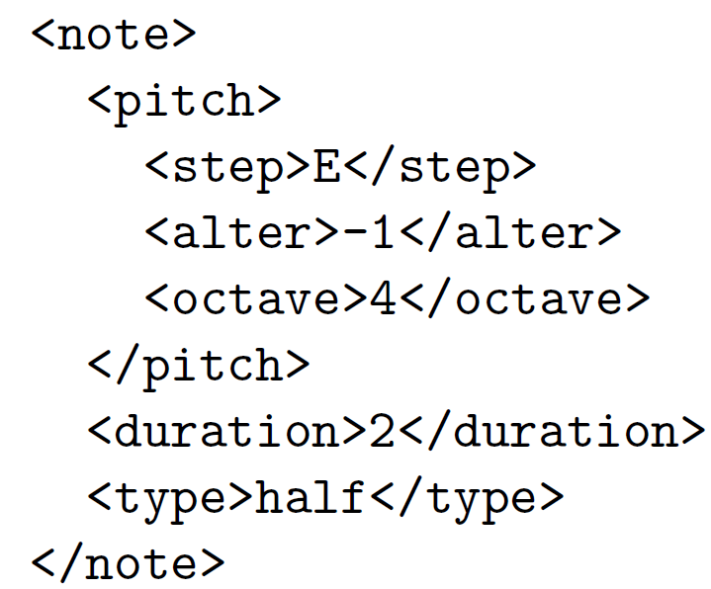
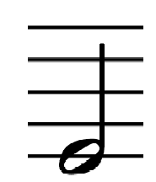
1.2 Symbolic Representations
Fig. 1.15

Slide 21
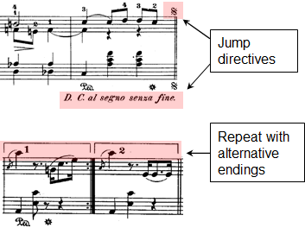
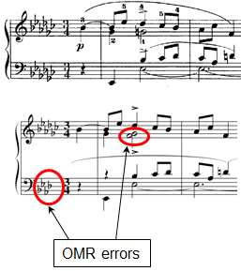
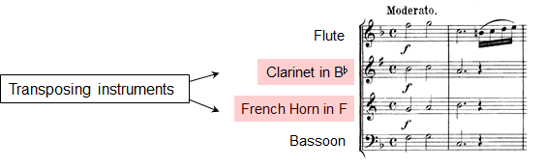
1.3 Audio Representations
Fig. 1.16

Slide 22
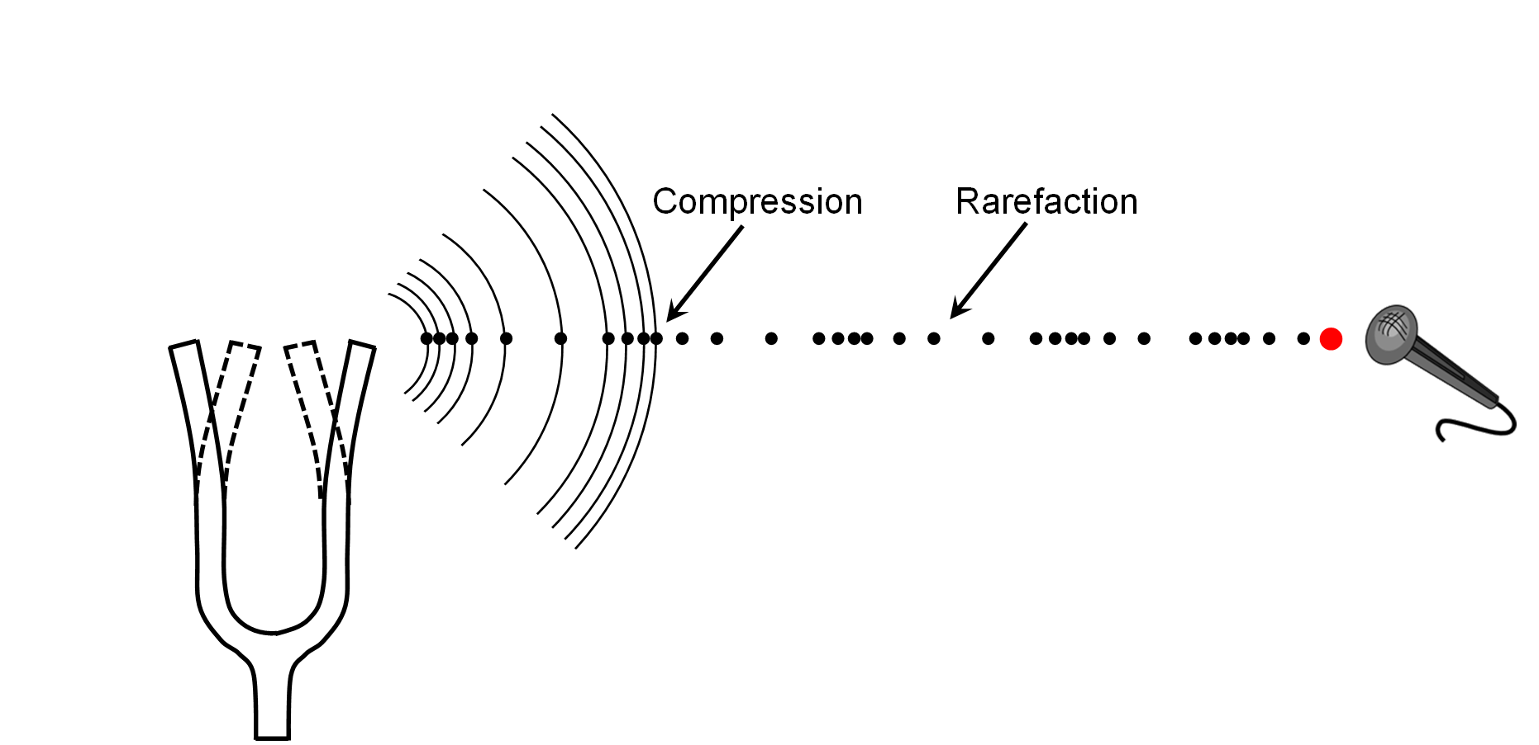
1.3 Audio Representations
Fig. 1.17

Slide 23
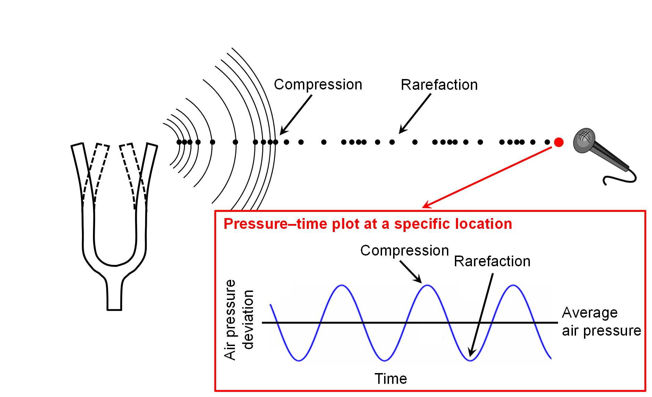
1.3 Audio Representations
Fig. 1.17

Slide 24
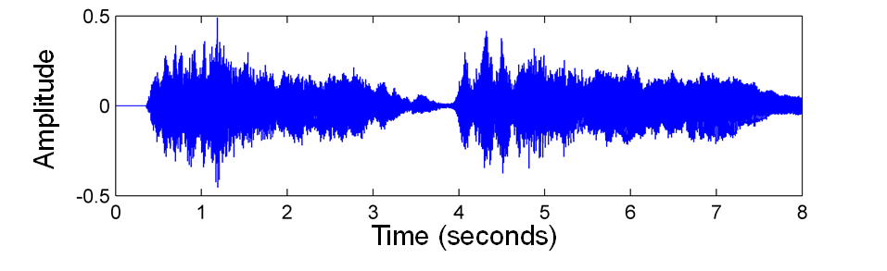
1.3 Audio Representations
Fig. 1.18

Slide 25
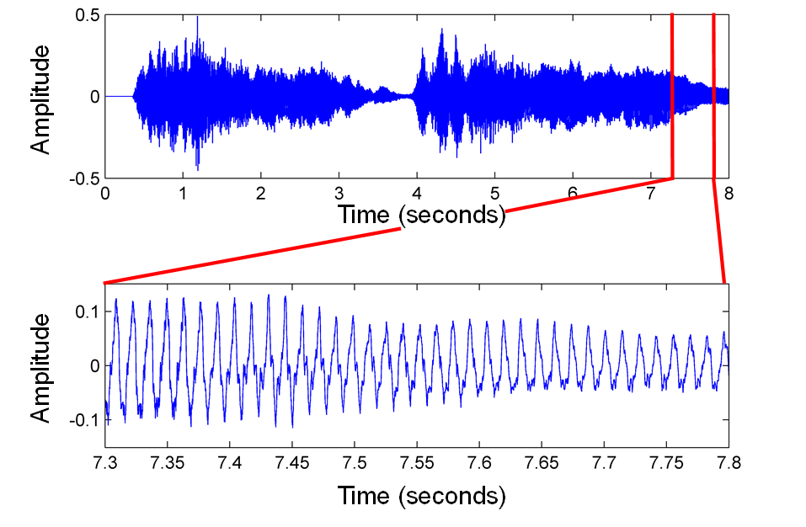
1.3 Audio Representations
Fig. 1.18

Slide 26
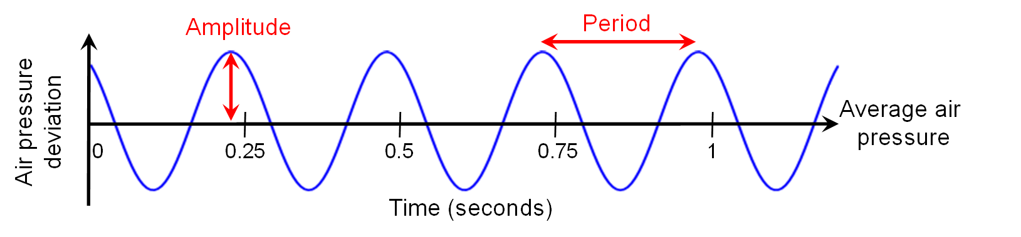
1.3 Audio Representations
Fig. 1.19

Slide 27
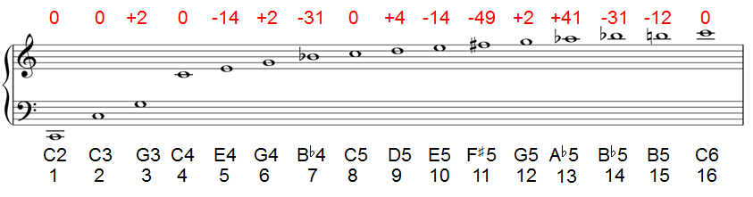
1.3 Audio Representations
Fig. 1.20

Slide 28
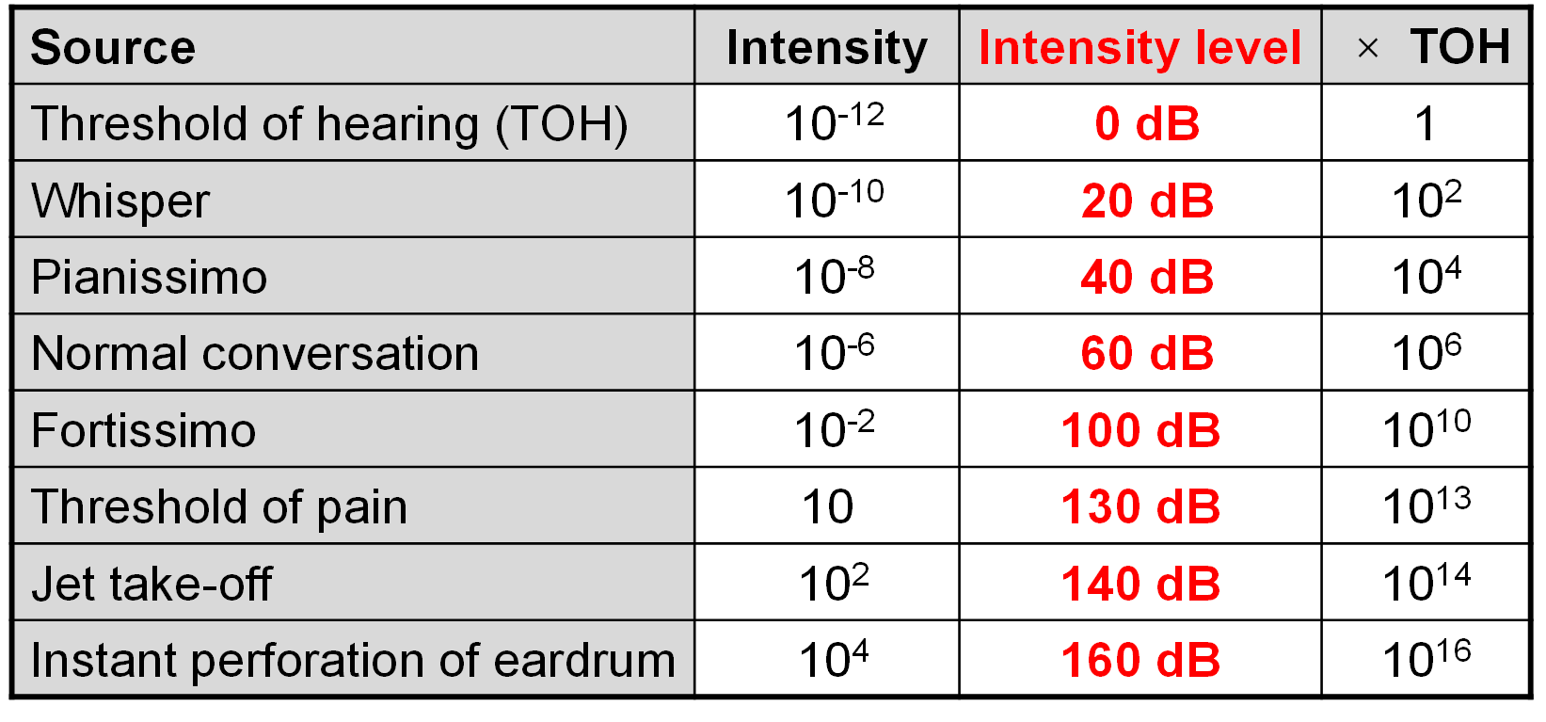
1.3 Audio Representations
Table 1.1

Slide 29
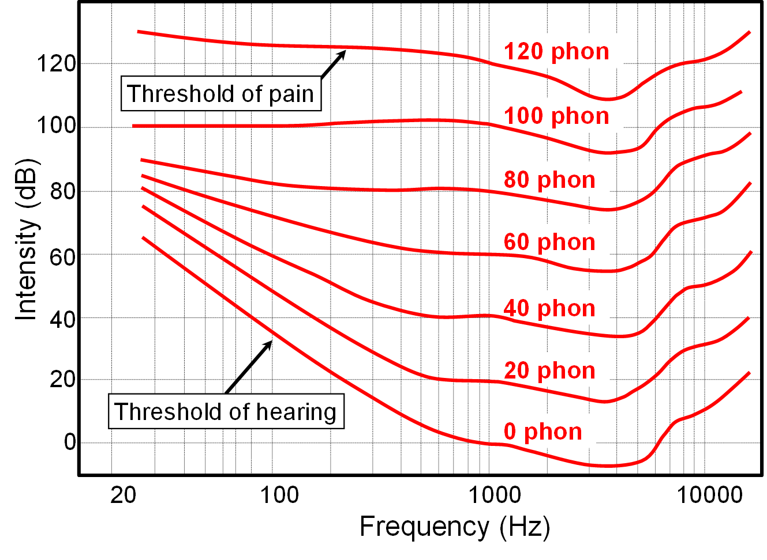
1.3 Audio Representations
Fig. 1.21

Slide 30
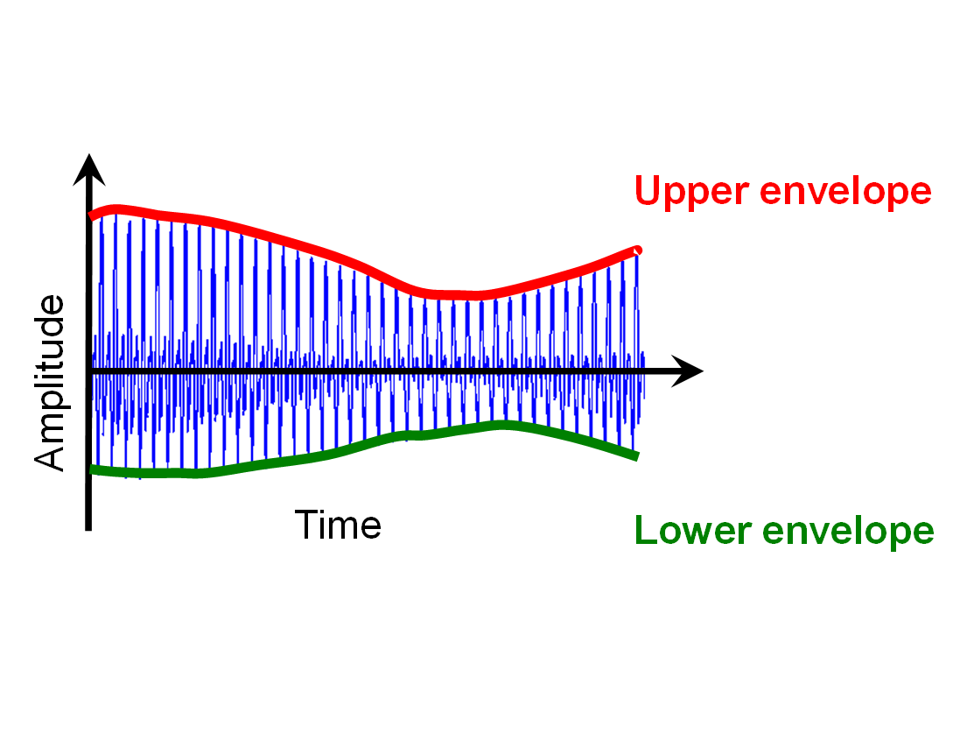
1.3 Audio Representations
Fig. 1.22

Slide 31
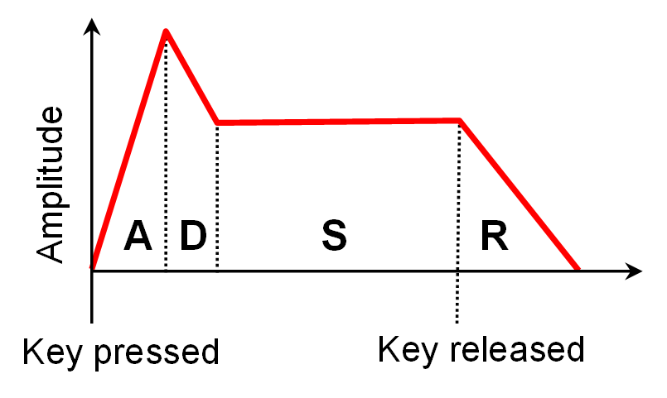
1.3 Audio Representations
Fig. 1.22

Slide 32
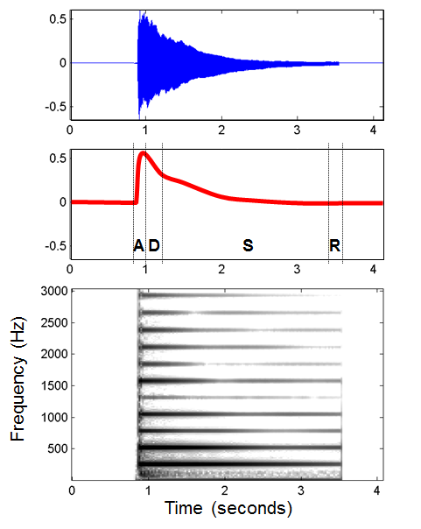
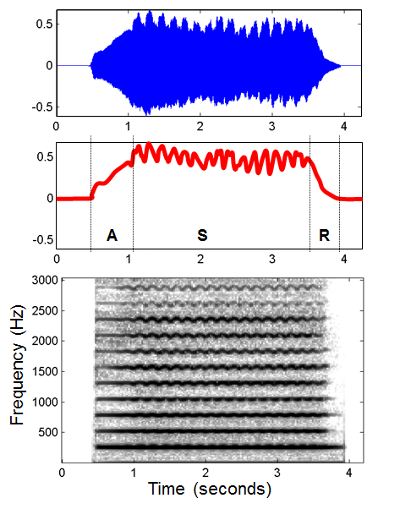
1.3 Audio Representations
Fig. 1.23

Slide 33
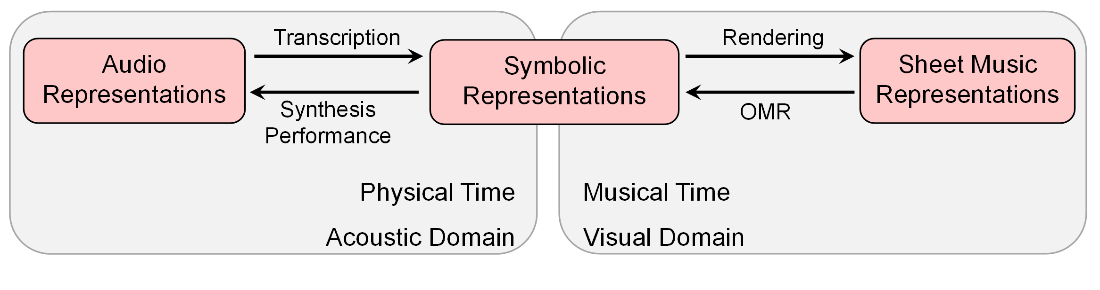
1.4 Further Notes
Fig. 1.24

